Slide 1

TRAINING MANAGEMENT SYSTEM
Zawadul Islam
Trainee J2EE, BJIT

Slide 2
Summary
Suitable environment for trainers and trainees
Communication and resource sharing
Sorting and scheduling everything in proper manner

Slide 3
Feature List
1
Login/Register
Create Trainee and Trainer profile
Authenticate
2
Batch
Create
Schedule
Assign Trainee, Trainers and Courses
3
Assignment
Create
Set Deadline
Submission
4
5
Classroom
Create post
Comment
Notice
Course
Create
Assign trainer
Schedule

Slide 4
Technologies & Tools
1
2
3
4
Java
+
JavaScript
Spring Boot
+
ReactJs
Intellij Idea
+
VS Code
JWT
Token

Slide 5
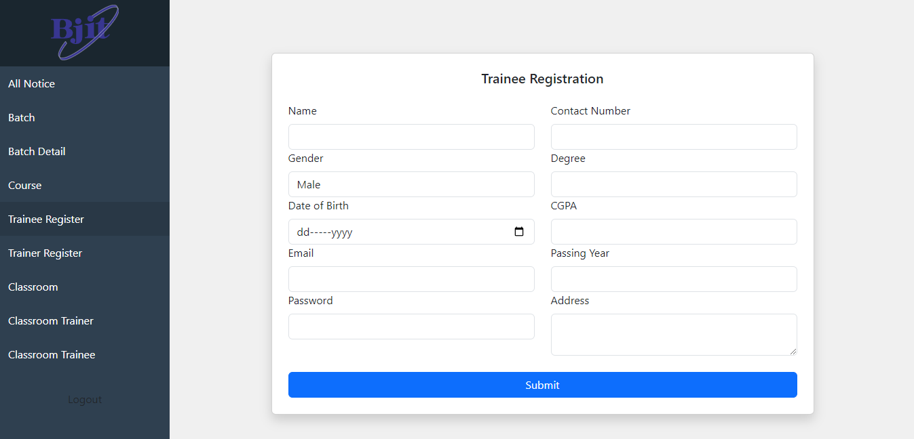
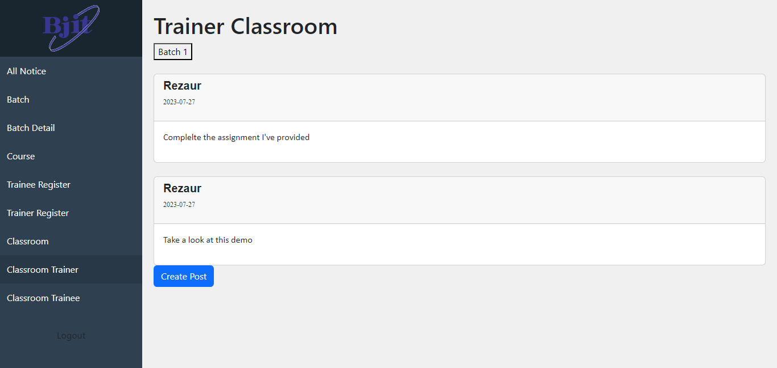
User Interface
Registration Page
Takes necessary input for the user and register the user into the system
Classroom
Trainer view of classroom. Trainer can see the batches he is assigned in and give posts to that classroom

Slide 6
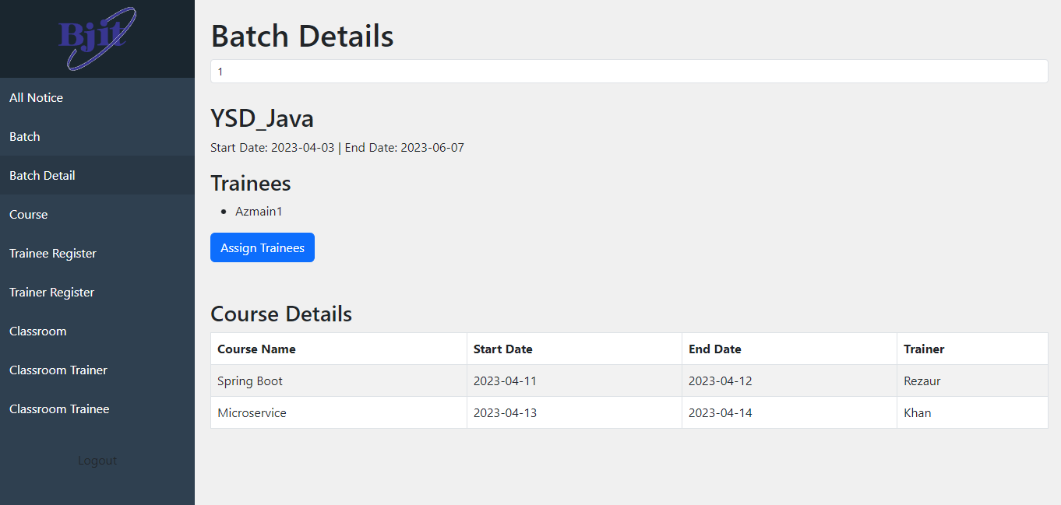
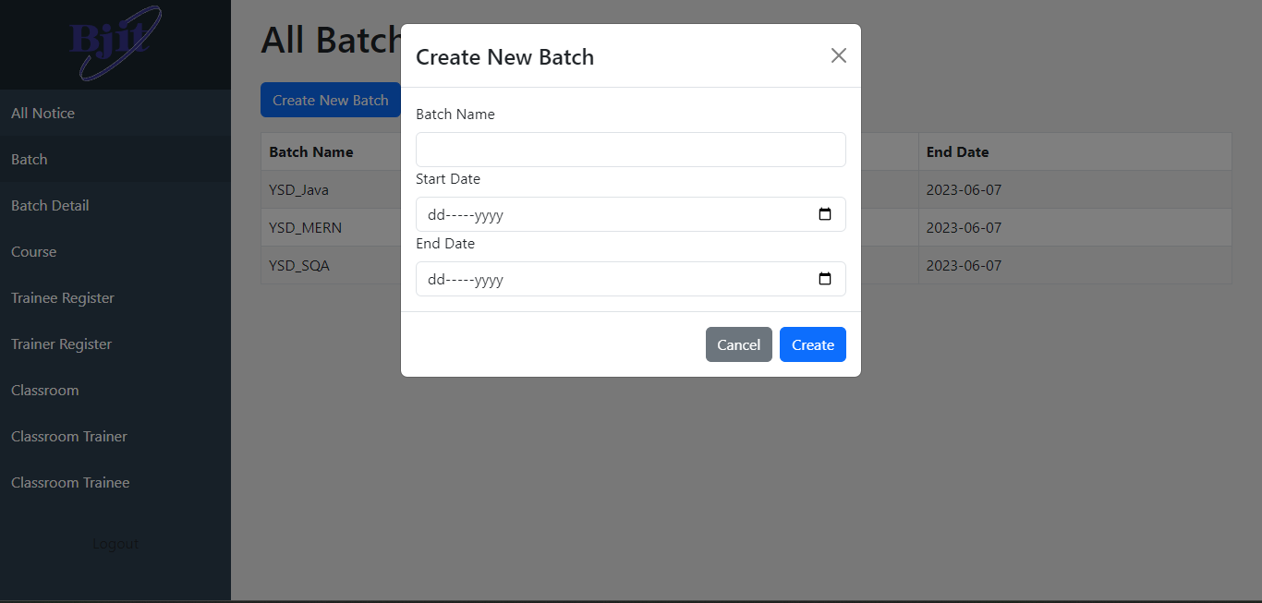
User Interface
Batch Detail
After entering the batch id, it shows necessary details of that batch. Also assign unassigned trainees to a batch.
Batch List and Create
Shows all batch and create batch with name, start date and date

Slide 7
Learnings
Planning and creating roadmap of creating project
Document necessary information
Java and Spring Boot fundamentals
Spring data JPA and database relation
Role based authentication and authorization
Basic idea about frontend (ReactJs)
Version control using git
Unit testing
Format code and file

Slide 8
Challenges
Defining relationship between entities
Security concerns
Managing and authorizing APIs
Integrating with frontend
Version control conflicts
Code maintainability and refactoring
Adapting with new tools
Balancing time and workload

Slide 9
Thank you

